Slide 1

Computational Models for Social Network Analysis
—mining big social networks (Part II: Social Interaction)
Jie Tang
Computer Science, Tsinghua University
@WWW’2017

Slide 2

Roadmap
data
User
Tie
Structure
Heterogeneous
Micro
Macro
tie
Dynamic
Influence
- User Modeling
- Demographics
- Social Role
- Social Tie/Link
- Homophily
- Social Influence
- Triad Formation
- Community
- Group Behavior
Big&Big
social
Social Theories
Graph Theories
BIG Networks

Slide 3
Roadmap
data
User
Tie
Structure
Heterogeneous
Micro
Macro
tie
Dynamic
Influence
- User Modeling
- Demographics
- Social Role
- Social Tie/Link
- Homophily
- Social Influence
- Triad Formation
- Community
- Group Behavior
Big&Big
social
Social Theories
Graph Theories
BIG Networks

Slide 4

This part…
Info. Space vs. Social Space
Problem 1: Who is who? (heterogeneity)
Info. Space
Problem: How people interact with each other?
Social Space
Interaction
[1] Jie Tang, Tiancheng Lou, Jon Kleinberg, and Sen Wu. Transfer Learning to Infer Social Ties across Heterogeneous Networks. ACM TOIS, 2016, Volume 34, Issue 2, Article No. 7.
[2] Tiancheng Lou, Jie Tang, John Hopcroft, Zhanpeng Fang, Xiaowen Ding. Learning to Predict Reciprocity and Triadic Closure in Social Networks. ACM TKDD, 2013, Volume 7, Issue 2, Article No. 5.
[3] Jie Tang, Jimeng Sun, Chi Wang, and Zi Yang. Social Influence Analysis in Large-scale Networks. KDD’09, pages 807-816.

Slide 5

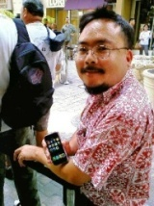
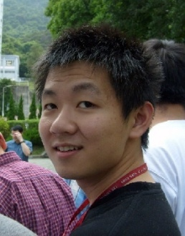
Social Tie Analysis
Family
?
Inferring social ties
Friend
?
Reciprocity
You
Lady Gaga
You
Lady Gaga
Triadic Closure
You
You
?
Lady Gaga
Shiteng
Lady Gaga
Shiteng
KDD 2010, PKDD 2011 (Best Paper Runnerup), WSDM 2012, ACM TKDD

Slide 6
Inferring Social Ties
Family
?
Friend
KDD 2010, PKDD 2011 (Best Paper Runnerup), WSDM 2012, DMKD

Slide 7
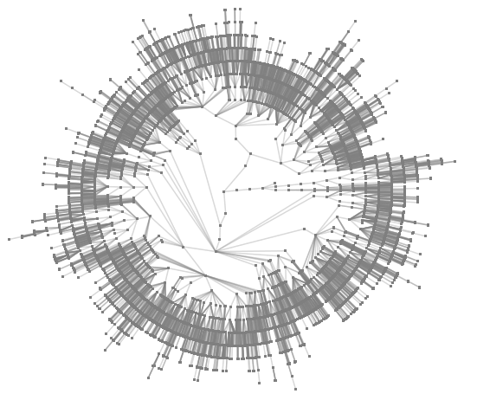
Example 1: finding boss in email networks
(PKDD’11, Best Paper Runnerup)
Enterprise email network
CEO
How to infer
Manager
Employee
User interactions may form implicit groups

Slide 8


Example 2: finding friends in mobile networks
Friends
Other
From Home
08:40
Both in office
08:00 – 18:00
0.89
0.98
From Office
11:35
0.77
From Office
15:20
From Office
17:55
0.63
0.70
From Outside
21:30
0.86
Notes:
Let me give some concrete examples of our problem. The first example is the mobile communication network. Mobile users communicate with each other by making calls and sending text messages. [Click] What we want to do is to infer the friendship in the communication network.

Slide 9
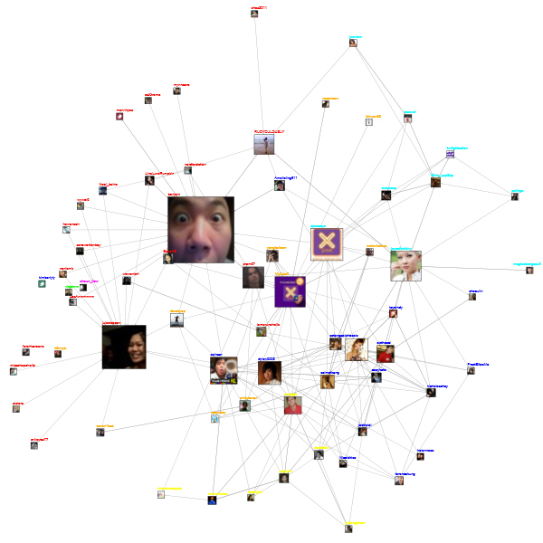
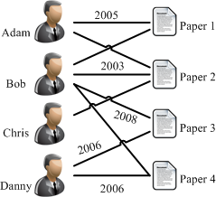
Challenges
What are the fundamental forces behind?
Can we automatically infer the type of social ties?
Publication network
From Home
08:40
Both in office
08:00 – 18:00
Twitter’s following network
From Office
11:35
From Office
15:20
From Office
17:55
From Outside
21:30
Mobile communication network

Slide 10
Networks
Epinions a network of product reviewers: 131,828 nodes (users) and 841,372 edges
  trust relationships between users
Slashdot: 82,144 users and 59,202 edges
  “friend” relationships between users
Mobile: 107 mobile users and 5,436 edges
  to infer friendships between users
Coauthor: 815,946 authors and 2,792,833 coauthor relationships
  to infer advisor-advisee relationships between coauthors
Enron: 151 Enron employees and 3572 edges
  to infer manager-subordinate relationships between users.
Undirected network
Directed network

Slide 11
Problem Formulation
  Input: G=(V,E^{L},E^{U},R^{L},W)
Partially Labeled Network
Other
Friend
V: Set of Users
E^{L},R^{L}: Labeled relationships
?
?
?
E^{U}: Unlabeled relationships
Other
Input:
  G=(V,E^{L},E^{U},R^{L},W)
Output:
f: G→R
Notes:
Now let’s give a formal definition of this problem. Basically, the input is a social network, which contains [Click] a set of users. In the social network, some relationships may be [Click] labeled, [Click] but most are not. Therefore, the input is a [Click] partially label network. [Click] In this problem, the input is a partially labeled network G, the objective is to learn a mapping function f, which can predict the relationship semantics for each relationship in the input social graph. It should be noted that, the partially-labeled property is very important. To learn a high-quality predictive model, we should not only consider the labeled information, but also the unlabeled network structure information.

Slide 12
Basic Idea
V₁
V₃
V₂
?
Friend
?
User→Node
?
?
r₂₄
r₅₆
Other
r₄₅
Relationship→Node
Notes:
Now, let’s discuss about the solutions. In general, there are two ways to model the problem. The first way is to model each user as a node [Click]. And another way is to model each relationship as a node [Click]
The first way is more intuitive, but it’s difficult to model the some correlations between different relationships. We use the second model.

Slide 13
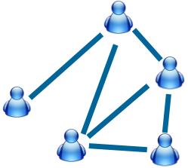
Partially Labeled Pairwise
Factor Graph Model (PLP-FGM)
Constraint factor h
y₂₁=Friend
Partially Labeled
Model
y₁₂=Friend
Latent Variable
y₁₆=Other
Correlation factor g
Problem:
For each relationship, identify which type
has the highest probability?
Attribute factors f
Input
Model
Map relationship to nodes in model
Example:
A makes call to B immediately after the call to C.
Example:
Call frequency between two users?
[1] Wenbin Tang, Honglei Zhuang, and Jie Tang. Learning to Infer Social Ties in Large Networks. In ECML/PKDD'2011. pp. 381-397. (Best Student Paper Runner-up)
Notes:
Now we introduce our partially labeled pairwise factor graph model in detail. Take the mobile network as example. The left side is input mobile social network. [Click] And the right side is the formulized model. [Click] Each relationship in the input network is mapped to a relationship node in the model. [click]
For each relationship node, we have a corresponding latent variable y. [click] The value of latent variable indicates the type of relationship.
In this model, we define three different factors.
The first factor is attribute factor. For each relationship, there may exist some user-specific/link-specific attributes which can reflect the relationship type.
For example:
How frequently two users make call to each other?
These features are added in to the model as "attribute factors.“
The second factor is correlation factor. Different relationships may have some correlations. Let's image such a situation, user Bob makes call to Alice immediately after the call to Carl. Then, the relationship between Bob and Alice, and the relationship between Bob and Carl, are very likely to be the same.
[Click]
The third factor is constraint factor. There also may exist some common knowledge that can help us to infer the relationship types.
[Click]
Finally, this model is a partially labeled model. Some of the nodes are labeled and some are not.
[Click]
Based on this model, The problem is cast as, for each relationship, identify which type has the highest probability.

Slide 14

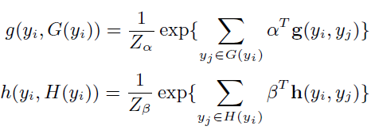

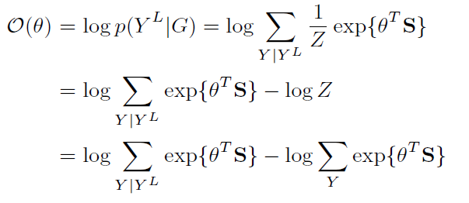
Solutions_{(con’t)}
Different ways to instantiate factors
  We use exponential-linear functions
    Attribute Factor:
    Correlation / Constraint Factor:
  Log-Likelihood of labeled Data:

Slide 15
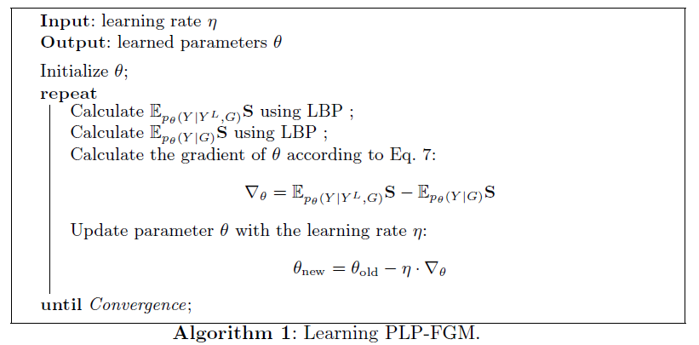
Learning Algorithm
Maximize the log-likelihood of labeled relationships
Expectation Computing
Loopy Belief Propagation
Notes:
//算法方块放大
Learning the model, is to estimate a parameter configuration \theta, so that the log-likelihood of observation information are maximized.
[Click]
Therefore, we use gradient decent method to estimate the parameters.
[Click]
And use loopy belief propagation to compute the gradient vector.
核心要说 说清楚 Partially Labeled 的计算方式， Run两次 LBP。

Slide 16
Distributed Learning
Compute Gradient
via LBP
Optimize
with Gradient Descent
Graph Partition
Master-Slave Computing
Notes:
As real social network may contain millions of users, it’s important for the learning algorithm to scale up well with large networks.
So we developed a distributed learning algorithm. The gradient descent learning algorithm can be viewed as two steps:
First, compute the gradient via loopy belief propagation. Second, optimize the parameters with gradient descents.
In these two steps, the Gradient computation step is the bottleneck. Therefore, we developed a distributed loopy belief propagation. [Click]
It’s based on MPI, using master-slave architecture.
Specifically, we partition the graphical model into P sub-graphs, and edges across sub-graphs are discarded.
In each step, we calculate the gradient information in each subgraph, and accumulate the information in master node.
// partition strategy is important.
// animation.
// random partition不好，这也是一个challenge
// Clustering based
// 这个算法是什么？ 人可能问。
// 要partition ，partitioned relative same number of nodes。 Load balance
// 多介绍一下METIS

Slide 17
Result
Data Set | Method | Precision | Recall | F1-score
Coauthor | SVM | 72.5 | 54.9 | 62.1
 | TPFG | 82.8 | 89.4 | 86.0
 | PLP-FGM-S | 77.1 | 78.4 | 77.7
 | PLP-FGM | 91.4 | 87.7 | 89.5
Enron | SVM | 79.1 | 88.6 | 83.6
 | PLP-FGM-S | 85.8 | 85.6 | 85.7
 | PLP-FGM | 88.6 | 87.2 | 87.9
Mobile | SVM | 92.7 | 64.9 | 76.4
 | PLP-FGM-S | 88.1 | 71.3 | 78.8
 | PLP-FGM | 89.4 | 75.2 | 81.6
SVM: Use the same feature to train a classification model
TPFG: An unsupervised method to identify advisor-advisee relationships^{[1]}
PLP-FGM-S: Train PLP-FGM model only using the labeled sub-graph
[1] Chi Wang, Jiawei Han, Yuntao Jia, Jie Tang, Duo Zhang, Yintao Yu, and Jingyi Guo. Mining Advisor-Advisee Relationships from Research Publication Networks. In KDD'10, pages 203-212.
Notes:
This is the performance in different datasets. We can see our algorithm shows better and robust performance.
An interesting observation is that, unlabeled data indeed helps. Without using unlabeled data, the model PLP-FGM-S results in a large performance reduction.
删掉accuracy
Baseline

Slide 18
Still Challenges?
Questions:
- How to obtain sufficiently training data?
- Can we leverage knowledge from other network?

Slide 19
Inferring Social Ties Across Networks
Epinions
Mobile
What is the knowledge to transfer?
[1] Jie Tang, Tiancheng Lou, Jon Kleinberg, and Sen Wu. Transfer Learning to Infer Social Ties across Heterogeneous Networks. ACM TOIS, 2016, Volume 34, Issue 2, Article No. 7.

Slide 20
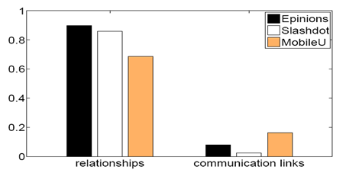
Social Theories
Social balance theory
Structural hole theory
Social status theory
Two-step-flow theory
Observations:
(1) The underlying networks are unbalanced;
(2) While the friendship networks are balanced.
Notes:
social balance theory suggests that people in a social network are incline to form into a balanced
network structure.
The phrase the enemy of my enemy is my friend is a proverb that advances the concept that someone who is the enemy of your enemy is therefore your friend.

Slide 21
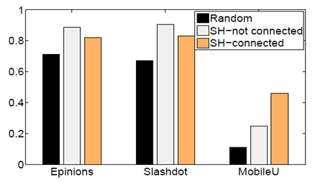
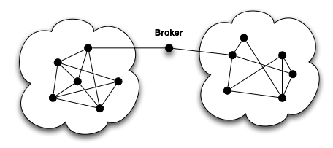
Social Theories—Structural hole
Social balance theory
Structural hole theory
Social status theory
Two-step-flow theory
Observations: Users are more likely (+25-150% higher than change) to have the same type of relationship with C if C spans structural holes
Structural hole
Notes:
The structural hole theory is an important extension of social network theory. Structural holes [1] in a social network indicate those people who can broker connections between otherwise disconnected sub networks.
Users are more likely (+70%) to have the same type of relationship with structural hole nodes.

Slide 22
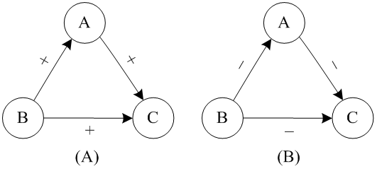
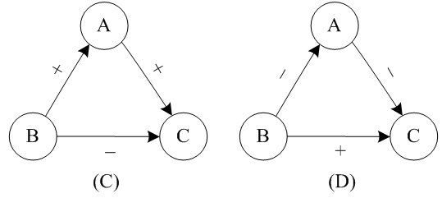
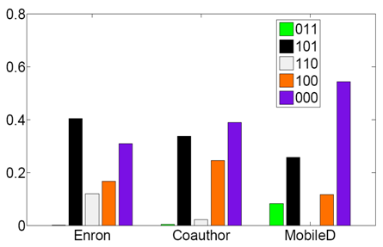
Social Theories—Social status
Social balance theory
Structural hole theory
Social status theory
Two-step-flow theory
Observations: 99% of triads in the networks satisfy the social status theory
Note: Given a triad (A,B,C), let us use 1 to denote the advisor-advisee relationship and 0 colleague relationship. Thus the number 011 to denote A and B are colleagues, B is C’s advisor and A is C’s advisor.
Notes:
early 99% of Triads in The three networks satisfy the social status theory, and they share a similar distribution on the five frequent forms of triads.

Slide 23
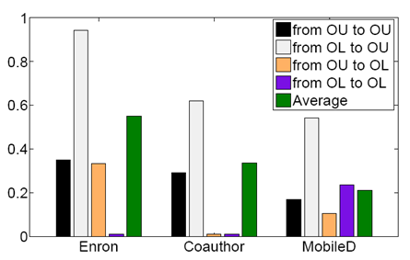
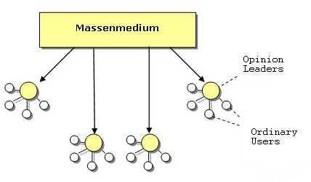
Social Theories—Two-step-flow
Social balance theory
Structural hole theory
Social status theory
Two-step-flow theory
OL : Opinion leader;
OU : Ordinary user.
Observations: Opinion leaders are more likely (+71%-84% higher than
chance) to have a higher social-status than ordinary users.
Notes:
Opinion leaders are more likely to have a higher social-status than ordinary users.

Slide 24
Transfer Factor Graph Model
Coauthor network
Bridge via social theories
mobile

Slide 25
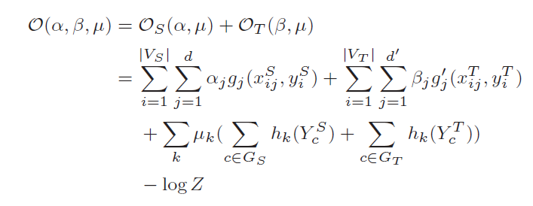
Mathematical Formulation
Features defined in source network
Features defined in target network
Triad-based features shared across networks
Jie Tang, Tiancheng Lou, and Jon Kleinberg. Inferring Social Ties across Heterogeneous Networks. In WSDM'2012. pp. 743-752.

Slide 26
Experiments
Data sets
  Epinions: 131,828 nodes (users) and 841,372 edges
  Slashdot: 82,144 users and 59,202 edges
  Mobile: 107 mobile users and 5,436 edges
  Coauthor: 815,946 authors and 2,792,833 coauthor relationships
  Enron: 151 Enron employees and 3572 edges
Comparison methods
  SVM and CRF are two baseline methods
  PFG is the partially-labeled factor graph model
  TranFG is the transfer–based factor graph model

Slide 27
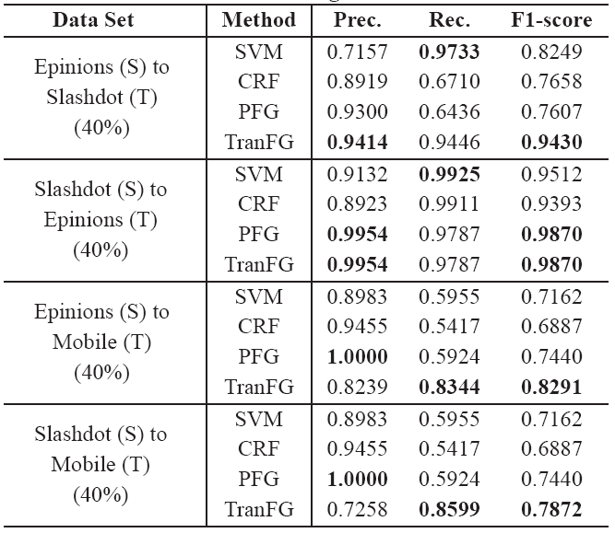
Results – undirected networks
SVM and CRF are two baseline methods
PFG is the proposed partially-labeled factor graph model
TranFG is the proposed transfer–based factor graph model.

Slide 28
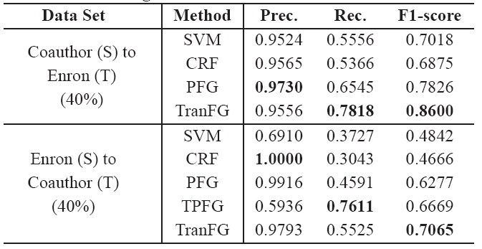
Results – directed networks
SVM and CRF are two baseline methods
PFG is the proposed partially-labeled factor graph model
TranFG is the proposed transfer–based factor graph model.

Slide 29
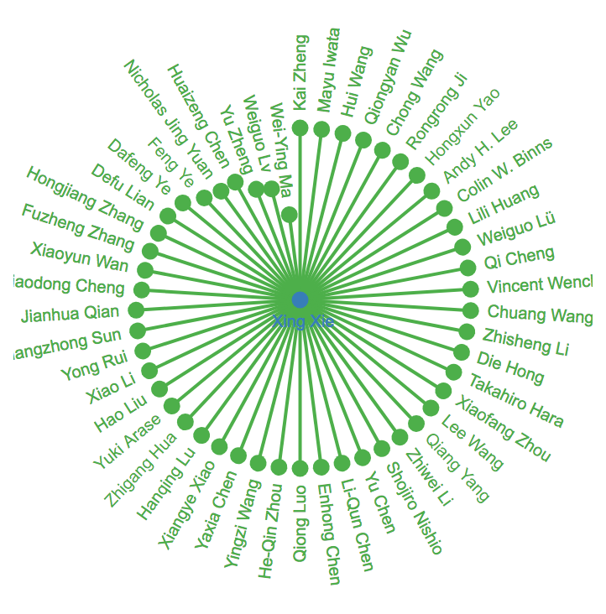
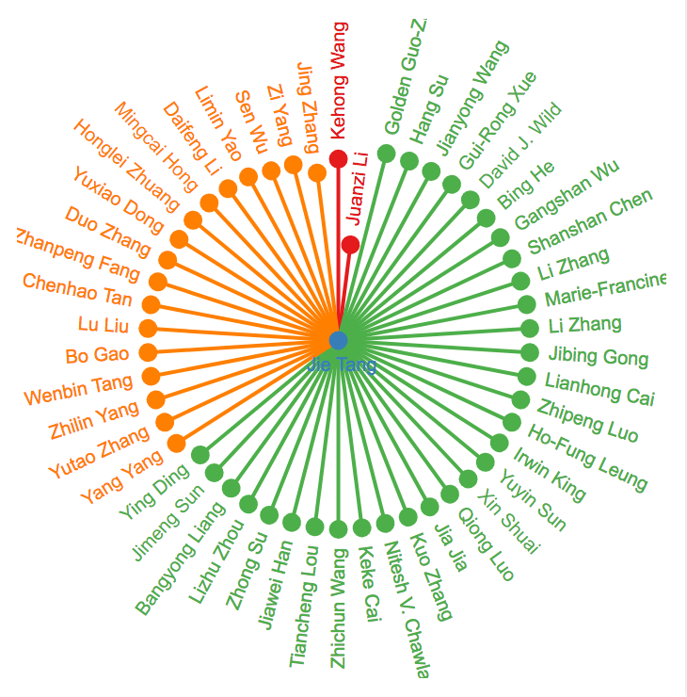
Inferring Social Ties in AMiner
Advisor
Advisee/
student

Slide 30
Beyond Connection (Tie)
—how people influence each other?
[1] Jie Tang, Jimeng Sun, Chi Wang, and Zi Yang. Social Influence Analysis in Large-scale Networks. KDD’09, pages 807-816.
[2] Jie Tang, Sen Wu, and Jimeng Sun. Confluence: Conformity Influence in Large Social Networks. KDD'13, pages 347-355.
[3] Jing Zhang, Jie Tang, Yuanyi Zhong, Yuchen Mo, Juanzi Li, Guojie Song, Wendy Hall, and Jimeng Sun. StructInf: Mining Structural Influence from Social Streams. AAAI'17.

Slide 31
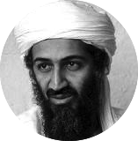


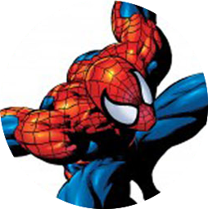

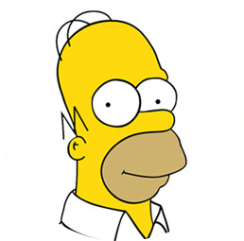
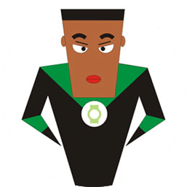
User Opinion and Influence: “Love Trump”
Trump makes USA great again
I hate Trump, the worst president ever
Trump is fantastic
Trump is great!
No Trump in 2012!
He cannot be the next president!
Positive
Negative
Notes:
Obama has done just that. From social networking to his blog to his Fight the Smears campaign, Obama has made his Web 2.0 presence known. He has over 1.5 million friends on MySpace and Facebook, and he currently has over 28,000,000 followers on Twitter. This personal activity in social networks allows him to quickly get the word out across multiple platforms.

Slide 32
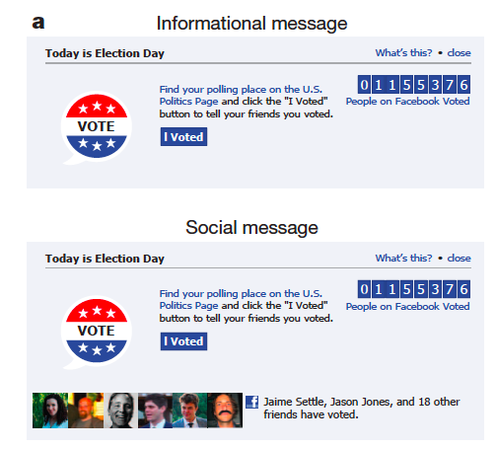
Social Interaction: Influence
Case 1: Social influence and political mobilization^{[1]}
  Will online political mobilization really work?
A controlled trial (with 61M users on FB)
Social msg group: was shown with msg that indicates one’s friends who have made the votes.
Informational msg group: was shown with msg that indicates how many other.
Control group: did not receive any msg.
[1] R. M. Bond, C. J. Fariss, J. J. Jones, A. D. I. Kramer, C. Marlow, J. E. Settle and J. H. Fowler. A 61-million-person experiment in social influence and political mobilization. Nature, 489:295-298, 2012.

Slide 33
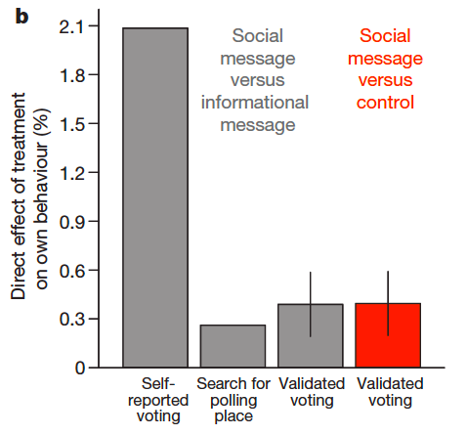
Social Influence and Political Mobilization
Social msg group v.s.
Info msg group
Result: The former were 2.08% (t-test, P<0.01) more likely to click on the “I Voted” button
Social msg group v.s.
Control group
Result: The former were 0.39% (t-test, P=0.02) more likely to actually vote (via examination of public voting records)
[1] R. M. Bond, C. J. Fariss, J. J. Jones, A. D. I. Kramer, C. Marlow, J. E. Settle and J. H. Fowler. A 61-million-person experiment in social influence and political mobilization. Nature, 489:295-298, 2012.

Slide 34
Social Influence Analysis: not just testing
Who influenced who? What is the influence probability?
Can we leverage the social influence to help practical applications?
1
2
Trump makes USA great again
I hate Trump, the worst president ever
Trump is fantastic
0.74
0.3
0.1
0.05
0.1
0.2
0.4
0.5
No Trump in 2012!
Trump is great!
0.7
He cannot be the next president!
Positive
Negative
Notes:
Obama has done just that. From social networking to his blog to his Fight the Smears campaign, Obama has made his Web 2.0 presence known. He has over 1.5 million friends on MySpace and Facebook, and he currently has over 60,000,000 followers on Twitter. This personal activity in social networks allows him to quickly get the word out across multiple platforms.

Slide 35
Formulation: Topic-based Social Influence Analysis
Topics
I hate Obama
Market Strategy
Politics
Politics
Entertainment
Trademarks
I love Obama
Positive
Negative
How to?
output
Politics
0.3
0.7
0.1
0.74
0.2
0.4
0.05
0.5
0.1

Slide 36
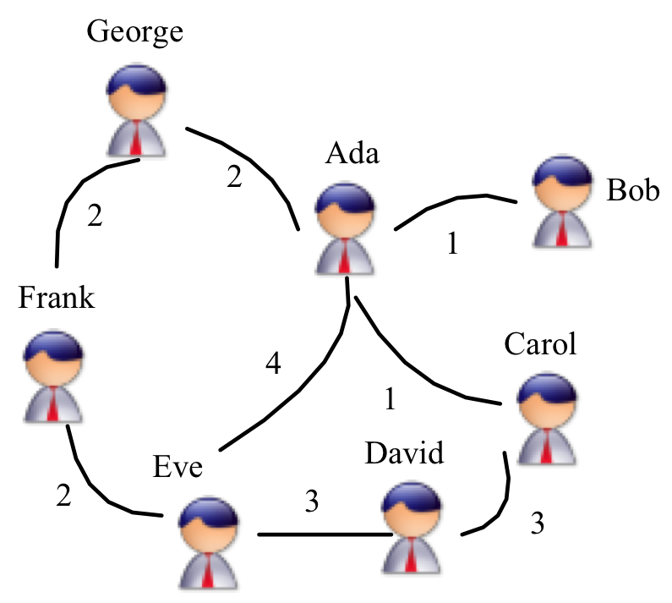
The Solution: Topical Affinity Propagation
Basic Idea:
If a user is located in the center of a “Market” community, and is “similar” to the other users, then she/he would have a strong influence on the other users.
—Homophily theory
Strategy
Market
Market
Strategy
Market
Market
Strategy
[1] Jie Tang, Jimeng Sun, Chi Wang, and Zi Yang. Social Influence Analysis in Large-scale Networks. KDD’09, pages 807-816.

Slide 37
The Solution: Topical Affinity Propagation
Define a function to quantify the similarity between neighborhood users
Market Strategy
Politics
How “Ada” thought he influenced “Bob”?
How “Bob” thought he was influenced by “Ada”?
Politics
Estimate how a user can represent his neighbors
Market Strategy
Politics
The topic information can be obtained by any tagging system or topic modeling approach
Politics
Market Strategy
[1] Jie Tang, Jimeng Sun, Chi Wang, and Zi Yang. Social Influence Analysis in Large-scale Networks. KDD’09, pages 807-816.

Slide 38
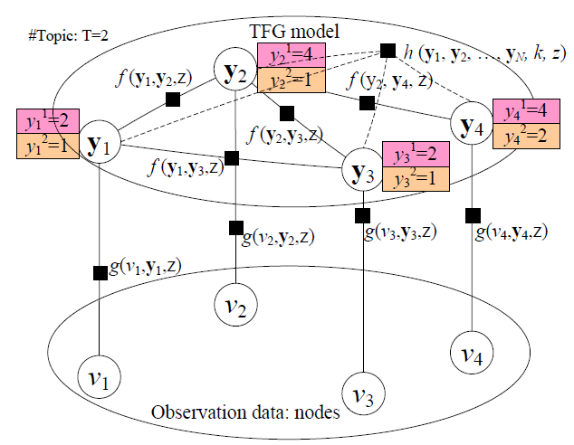
Topical Factor Graph (TFG) Model
Asymmetric similarity
Topological feature or global constraint
Social link
Nodes that have the highest influence on the current node
User-specific attributes
Node/user
The problem is cast as identifying which node has the highest probability to influence another node on a specific topic along with the edge.

Slide 39
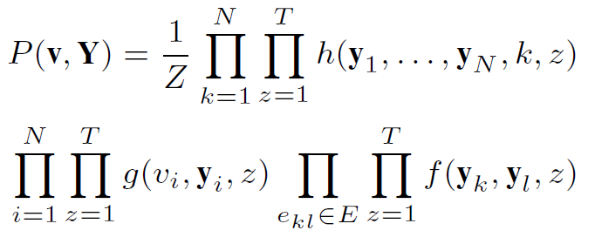
Topical Factor Graph (TFG)
The learning task is to find a configuration for all {y_{i}} to maximize the joint probability.
Objective function:
1. How to define?
2. How to optimize?
Notes:
目标函数P描述了隐变量y_i取任意一组值时的联合概率分布

Slide 40
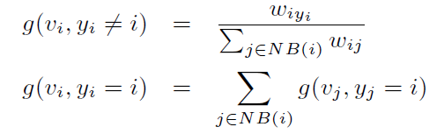
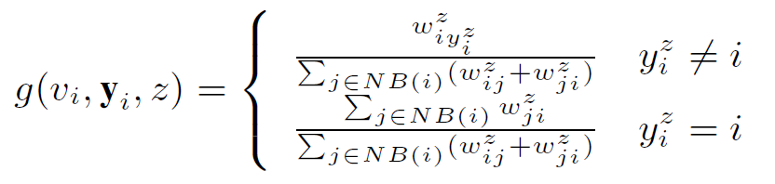

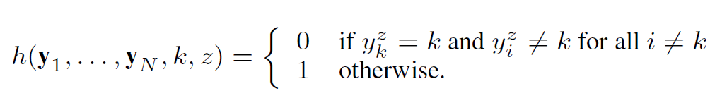
How to define (topical) feature functions?
similarity
  Node feature function
  Edge feature function
  Global feature function
or simply binary

Slide 41
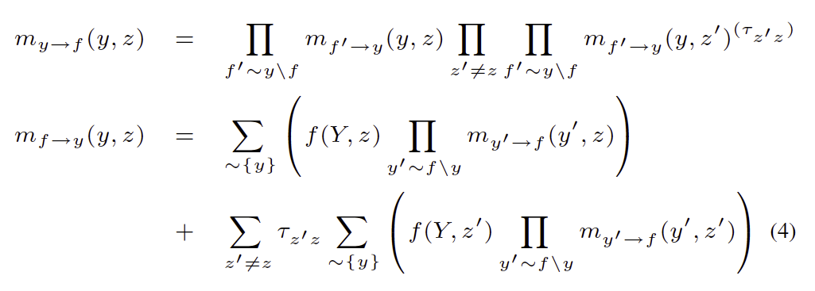
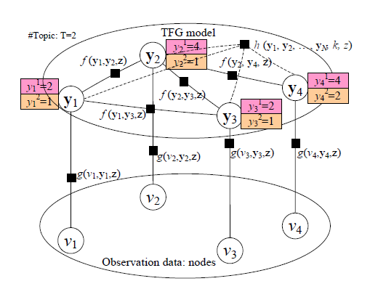
Model Learning Algorithm
Sum-product:
- Low efficiency!
- Not easy for distributed learning!

Slide 42
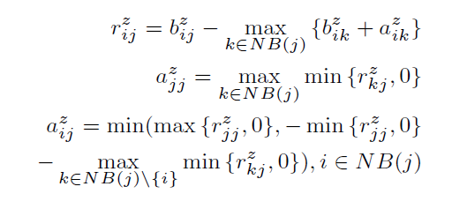
New TAP Learning Algorithm
1. Introduce two new variables r and a, to replace the original message m.
2. Design new update rules:
How user i thought he influenced user j?
m_{ij}
How user j thought he was influenced by user i?
[1] Jie Tang, Jimeng Sun, Chi Wang, and Zi Yang. Social Influence Analysis in Large-scale Networks. In KDD, pages 807-816, 2009.

Slide 43
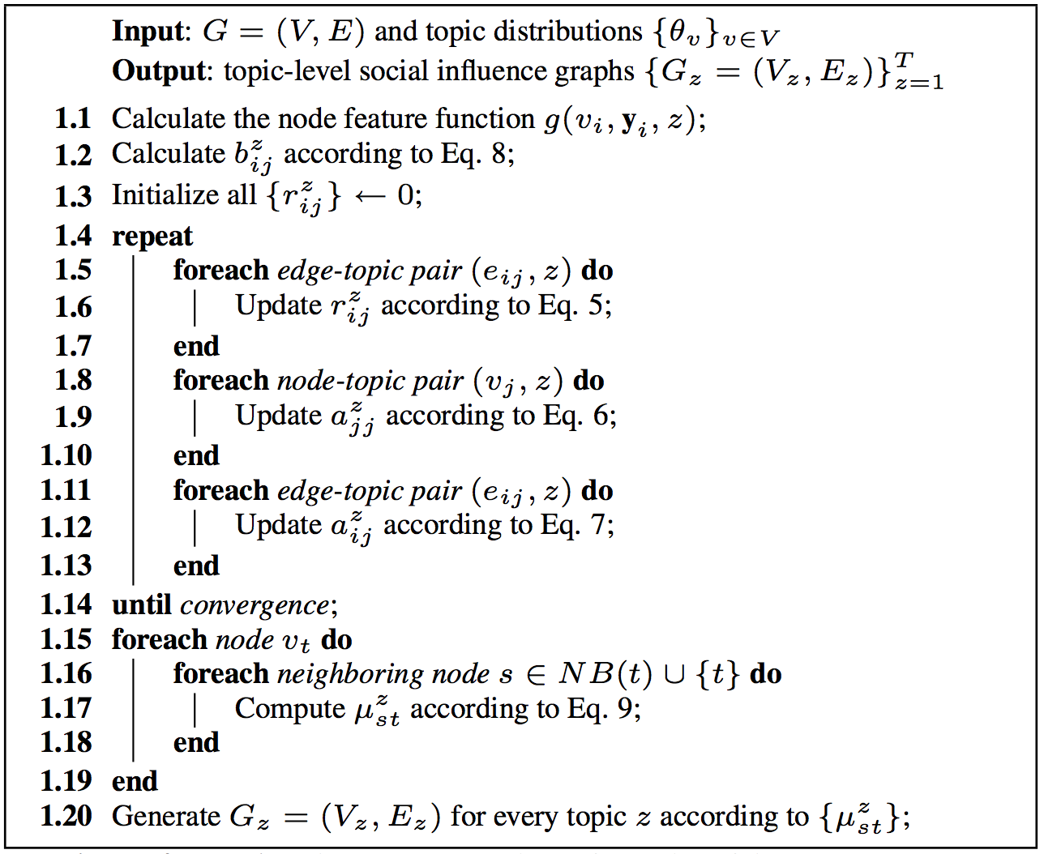





The TAP Learning Algorithm

Slide 44
We applied the learned influence to help real applications
—in very big Tencent networks

Slide 45
Big Data Analytics in Game Data
Online gaming is one of the largest industries on the Internet…
Facebook
  250 million users play games monthly
  200 games with more than 1 million active users
  12% of the company’s revenue is from games
Tencent (Market Cap: ~150B $)
  More than 400 million gaming users
  50% of Tencent’s overall revenue is from games
[1] Zhanpeng Fang, Xinyu Zhou, Jie Tang, Wei Shao, A.C.M. Fong, Longjun Sun, Ying Ding, Ling Zhou, and Jarder Luo. Modeling Paying Behavior in Online Social Networks. CIKM'14.

Slide 46

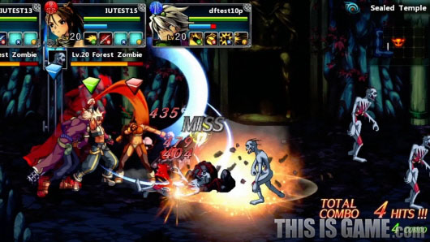
Two games: DNF
Dungeon & Fighter Online (DNF)
  A game of melee combat between users and large number of underpowered enemies
  400+ million users, the 2nd largest online game in China
  Users in the game can fight against enemies by individuals or by groups

Slide 47
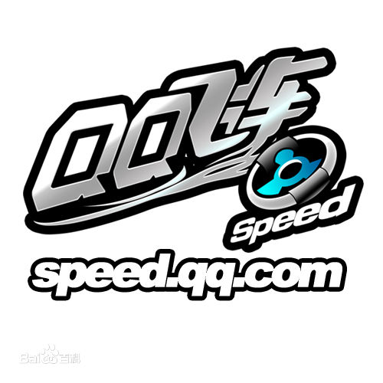
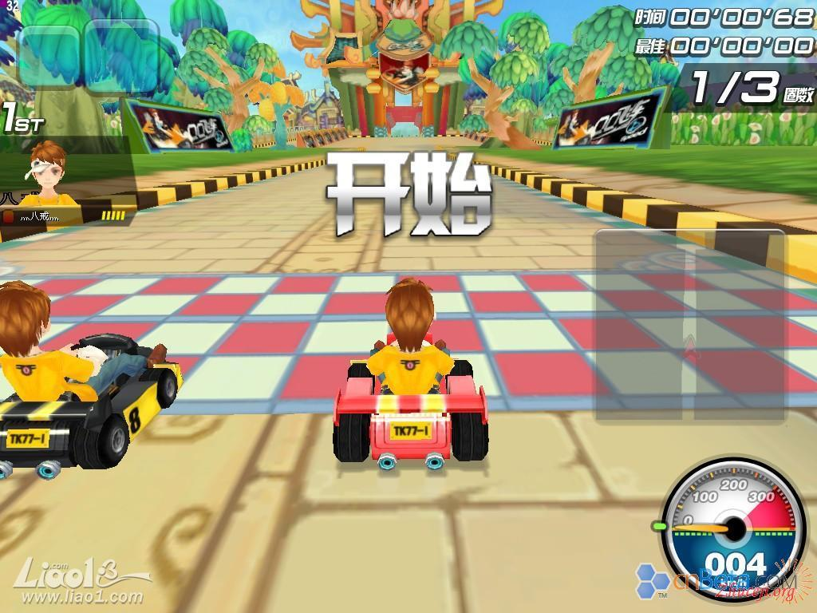
Two games: QQ Speed
QQ Speed
  A racing game that users can partake in competitions to play against other users
  200+ million users
  Users can race against other users by individuals or forma a group to race together
  Some users may pay…

Slide 48
Task
Given behavior log data and paying logs of online game users, predict
Will social influence play an important role in this task?
Free users -> Paying users

Slide 49
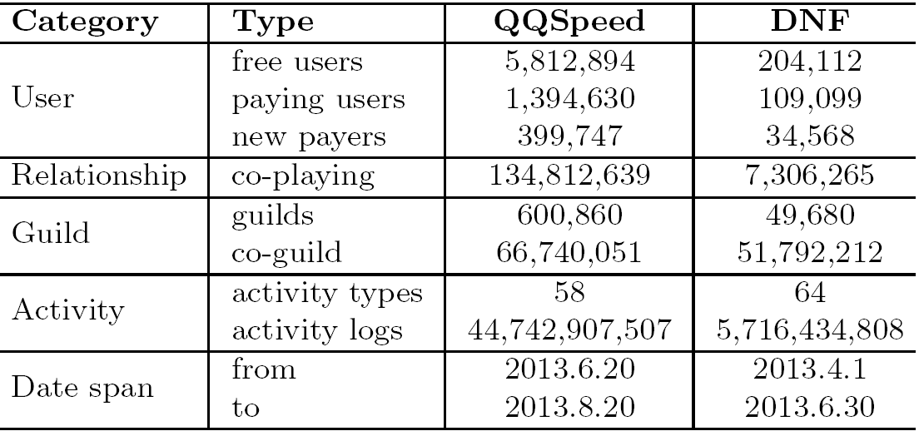
The Big social data
Statistics of the datasets

Slide 50
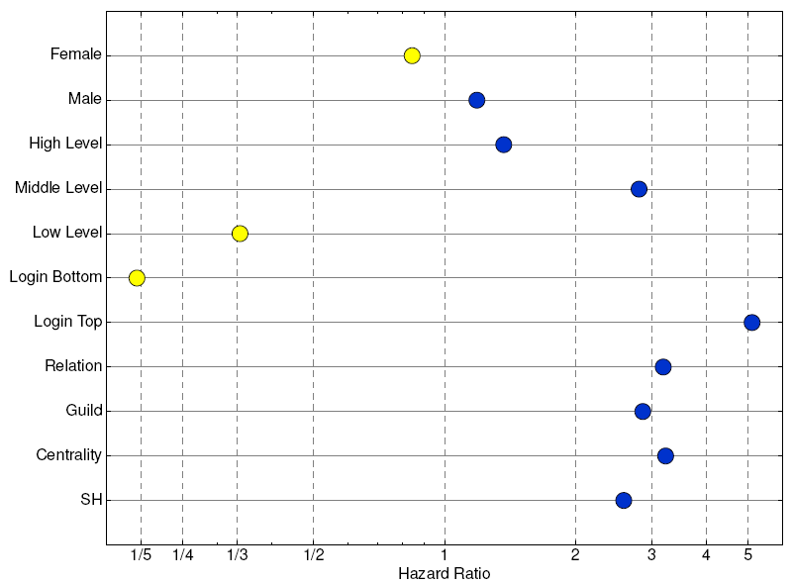
Demographics Analysis

Slide 51
Analysis – Social influence
Social network construction
  Co-playing network
Social relationship
  Social influence
  Strong/Weak tie
  Status
Structural influence

Slide 52
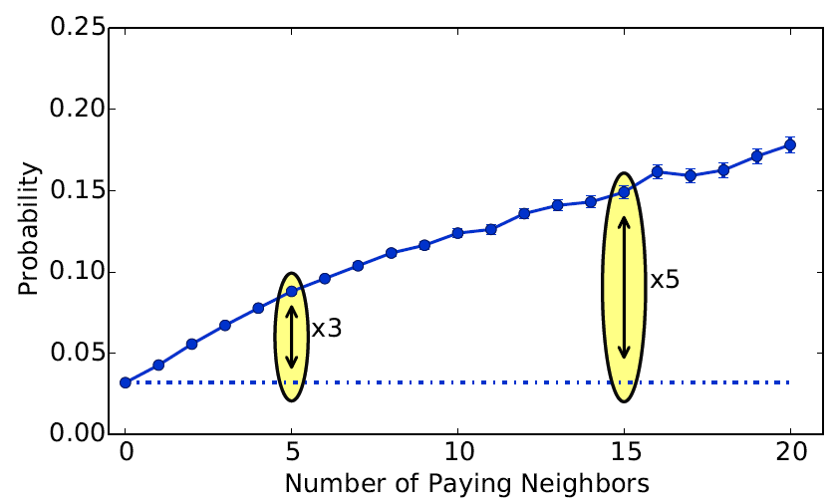
Social Influence

Slide 53
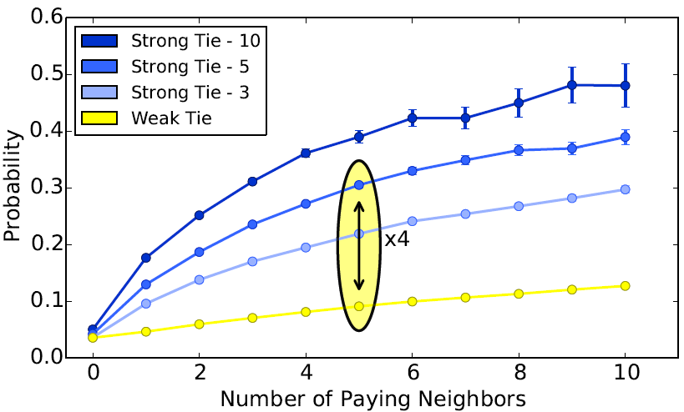
Influence + Tie Strength

Slide 54
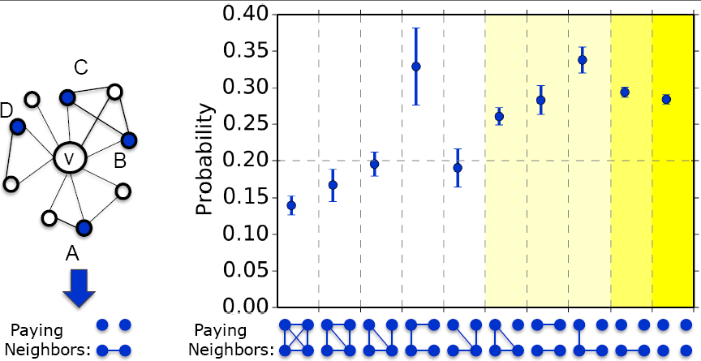
Structural Influence
[1] J. Ugandera, L. Backstromb, C. Marlowb, and J. Kleinberg. Structural diversity in social contagion. PNAS, 109 (20):7591-7592, 2012.
Notes:
最后，我们尝试从关系的多样性上进行分析。上图展示了不同的付费邻居的结构对新付费行为的影响。在上图，我们主要考察了有4个付费邻居的情况。X轴表示这4个付费邻居不同的结构情况，y轴表示成为付费用户的概率。可以看到，如果付费邻居之间的关系越稀疏，用户成为新付费用户的概率越大。付费邻居形成的连通块越多，用户成为新付费用户的概率越大。实验结果基本和DNF一致。

Slide 55

Factorization Machines
The prediction of feature vector x_{i}:
and the corresponding objective function:
[1] Zhanpeng Fang, Xinyu Zhou, Jie Tang, Wei Shao, A.C.M. Fong, Longjun Sun, Ying Ding, Ling Zhou, and Jarder Luo. Modeling Paying Behavior in Online Social Networks. CIKM'14.

Slide 56
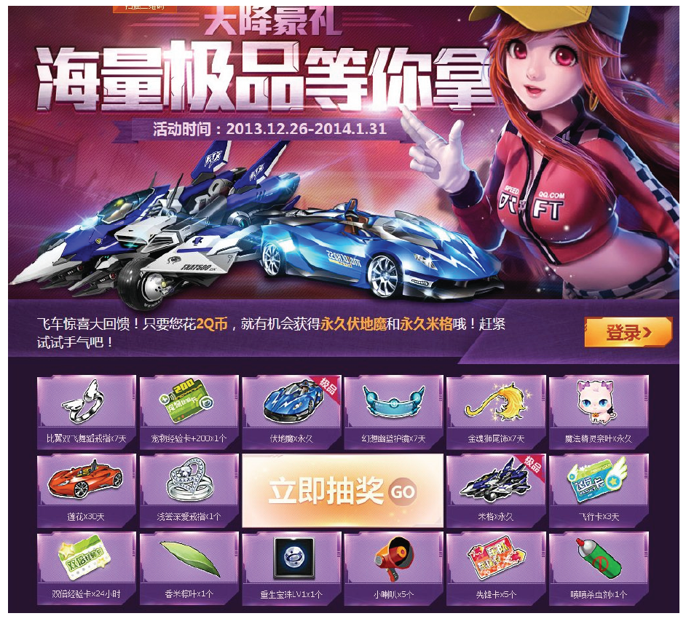
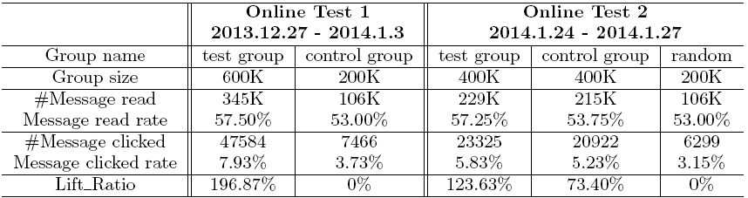
Online Test
Test setting
  Two groups: test group and control group
  Send msgs to invite the user to attend a promotion activity.
test group2
control group

Slide 57
From Peer Influence to Structural Influence
[1] Jie Tang, Sen Wu, and Jimeng Sun. Confluence: Conformity Influence in Large Social Networks. KDD'13, pages 347-355.
[2] Jing Zhang, Jie Tang, Yuanyi Zhong, Yuchen Mo, Juanzi Li, Guojie Song, Wendy Hall, and Jimeng Sun. StructInf: Mining Structural Influence from Social Streams. AAAI'17.

Slide 58
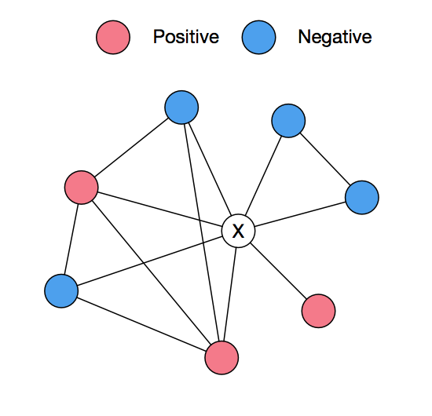
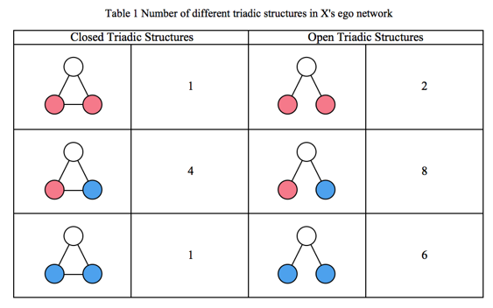

Further beyond peer influence
Influence is a very complicated mechanism
  Peer influence
  Conformity influence
  Individual influence
or
?
Positive or negative?

Slide 59

Triadic Influence
Learning influence in signed triads
And apply the triadic influence for prediction

Slide 60

Results
By adding the triadic influence as features for prediction on Weibo and Tencent CF (CrossFire)*
LRC—Logistic Regression; N—Peer influence feature only;
B—Basic features; T—Triadic influence features
* On Weibo, we predict who will (re)tweet a message; on Tencent CF, we predict will a free user becomes a paying user.

Slide 61
Generalized to other scenarios
Generalization: other problem + other dataset
  Problem: Call back of users
  Game data: King of Glory
 | With Influence |  |  | w/o influence
Top k | #message | #success | ratio | #message | #success | ratio
1 | 3996761 | 1953709 | 48.88% | 6617662 | 2732167 | 41.29%
2 | 2567279 | 1272037 | 49.55% | 9756330 | 4116895 | 42.20%
3 | 1449256 | 727728 | 50.21% | 10537994 | 4474236 | 42.46%
4 | 767239 | 389588 | 50.78% | 9891868 | 4255347 | 43.02%
5 | 3997251 | 2024859 | 50.66% | 15695743 | 6589022 | 41.98%

Slide 62

Generalized to complex structures

Slide 63

Counting in Structural Influence
v_{1,} a_{1,} t₁
v_{1,} a_{1,} t₁
v₁
v_{0,} a_{1,} t₂
v_{0,} a_{1,} t₂
v_{3,} a_{1,} t₂
v_{3,} a_{1,} t₂
a₁
v_{2,} a_{1,} t₃
v₀
v₃
v_{2,} a_{1,} t₃
Active target action
v_{3,} a_{2,} t₃
v₂
v₅
v_{2,} a_{2,} t₄
v_{3,} a_{2,} t₃
…
Inactive target action
a₂
v_{2,} a_{2,} t₄
v_{5,} a_{2,} t₅
Network
Action logs
Action diffusion graphs

Slide 64





Fast Sampling
StructInf-S1
StructInf-S2
  Complete subgraph
  Incomplete subgraph
StructInf-S3
  Complete subgraph
  Incomplete subgraph
Complete subgraph
Incomplete subgraph
Notes:
采样方法的首要目标是达到无偏估计。分析这三种采样方法的无偏性。发现对于采样方法1，只要用采样得到的数量，例如xk，除以采样的概率，即可以得到真实值的一个无偏估计。这里的采样概率指的是一个影响模式被采到的概率。因为第一种采样方法是采点，所以采样概率等于模式中所有点被采到的乘积。
第二种采样方法的无偏估计略微复杂。当一个影响模式是完全图的时候，可以像第一种方法一样，用采样得到的数量，例如xk，除以采样的概率，得到一个无偏估计。第二个方法因为是采边，所以采样概率等于模式中所有边被采到的乘积。但如果一个影响模式是非完全图，则用这样的办法得到的数量，不但包含模式Ck的数量，还包含与之有着相同点数，并包含Ck作为子图的模式，这是因为先通过采边生成一个子的diffusion graph，然后在采样的diffusion graph上做遍历，得到的模式经过还原可能对应到它的任何一个父模式。因此，为了得到一个模式的无偏估计，需要先计算出一个当前模式以及所有父模式和的无偏估计，然后再减去所有父模式的无偏估计。
第三种采样方法，当完全图的时候，用xk，除以点采样的概率以及边采样的概率。当非完全图的时候与第二种方法类似。

Slide 65


Variance vs. Sampling Speed
Variance:
The higher the sampling probability , the smaller the variance will be, while the sampling speed will be slower.
Trade off error and time by p and q
Notes:
接下来分析采样方法的方差和执行时间。由无偏估计的期望可以推导出无偏的方差估计。可以看到，第二部分只有当两个模式交集（点集或者边集）不为空时，才大于0。所以第二部分比之第一部分要小的多，可以忽略不计。这样可以得到方差基本上只跟当前模式的采样概率有关。方差要求越小，则采样概率越大，所需要的时间也就越长。因此，在实践中，需要调节参数p或者q，用来平衡错误率和时间。

Slide 66
Results
Prediction Performance
Retweet behavior prediction
Variance vs. Speed
Basic features: the number of friends, gender, verification status of the user
C1 : the number of active neighbors
weak : IP < 0:1, moderate : 0.1 < IP < 0.3, strong: IP > 0.3
[1] Jing Zhang, Jie Tang, Yuanyi Zhong, Yuchen Mo, Juanzi Li, Guojie Song, Wendy Hall, and Jimeng Sun. StructInf: Mining Structural Influence from Social Streams. AAAI'17.

Slide 67
Roadmap
data
User
Tie
Structure
Heterogeneous
Micro
Macro
tie
Dynamic
Influence
- User Modeling
- Demographics
- Social Role
- Social Tie/Link
- Homophily
- Social Influence
- Triad Formation
- Community
- Group Behavior
Big&Big
social
Social Theories
Graph Theories
BIG Networks

Slide 68
Thank you！
Collaborators: John Hopcroft, Jon Kleinberg, Chenhao Tan (Cornell)
Jiawei Han (UIUC), Philip Yu (UIC)
Jian Pei (SFU), Hanghang Tong (ASU)
Tiancheng Lou (Google&Baidu), Jimeng Sun (GIT)
Wei Chen, Ming Zhou, Long Jiang, Chi Wang, Yuxiao Dong (Microsoft)
Yutao Zhang, Jing Zhang, Zhanpeng Fang, Zi Yang, Sen Wu, etc. (THU)
  Jie Tang, KEG, Tsinghua U, http://keg.cs.tsinghua.edu.cn/jietang
  Download all data & Codes, http://arnetminer.org/data
  http://arnetminer.org/data-sna

